Slide 1
INNOVO INFRA
Our delivery capabilities
People and equipment provide the foundation for our next stage of growth
Workforce
Staff
Site operatives and skilled trades
Engineering, management and support
2026 headcount: 1295
2026 headcount: 2136
600+
Heavy equipment
2026 unit count: 180+
Fleet units
Rayan El Eid, Managing Director • Quarterly Board Meeting 2026
01
Notes:
Our capabilities combine site workforce, professional staff and a fleet of more than 200 units. Workforce and staff are separate categories. Exact counts and the 2026 heavy-equipment position remain unconfirmed. Fleet and heavy-equipment categories may overlap and must not be summed. Source: MD-supplied quarterly meeting note. Provisional navy, teal and white palette pending RBM Ark 4 reference.

Slide 2
INNOVO INFRA
Our competitive advantage
A company established only 4 years ago, with the ambition to compete with major industry players in the market.
Innovation is about creating values
New ideas
Challenge conventional methods and develop better ways to faster deliver and improve quality.
Digital delivery
Adapt BIM for clash analysis, Drone surveys and equipment control to decrease costs and increase productivity.
Practical technology that delivers better project results
Future opportunities in practical technology
Explore advanced surveying and new opportunities to strengthen our position and to deliver better projects results
Rayan El Eid, Managing Director • Quarterly Board Meeting 2026
02
Notes:
Our ambition is to compete through innovation and adaptability. We will focus on tools that improve productivity, reduce costs and raise quality. We will continue to explore opportunities that strengthen our competitive position. Source: MD-supplied note. Technology descriptions express future direction, not confirmed deployment.

Slide 3
INNOVO INFRA
Innovation in practice – Connecting Sites to Management.
Implemented initiatives that has improved accuracy, coordination and site productivity.
Introducing new out of the box suitable precast solutions in manholes and poles foundations to support efficient delivery and cost reduction.
01
Precast solutions
02
Dozer leveling
All our dozers have automated leveling control to improve productivity and reduce costs.
Pioneering in Building Information Modeling in infra works for coordination, reduce clashes prior to execution, planning and better control.
03
BIM adaptation
04
Drone surveys
Explore drone surveying to improve site data collection and visibility.
Intended outcome: lower operating costs, fewer delays and higher productivity
Rayan El Eid, Managing Director • Quarterly Board Meeting 2026
03
Notes:
Precast remains a general innovation initiative without technical detail. For dozer leveling, BIM and drones, this presentation describes exploration or planned implementation because deployment status was not confirmed. Source: MD-supplied note.

Slide 4
INNOVO INFRA
Creating measurable value
Technology investment should address real operational challenges and demonstrate results
Faster delivery
Higher productivity
Activity duration and milestone performance
Output per labor or equipment hour
Improved quality
Better project control
Rework hours and defect closure
Reporting timeliness and forecast accuracy
Reduced costs
Less material waste
Unit cost and verified savings
Waste quantity against material usage
Execution approach
Invest across teams, connect site data with management and optimize resources.
Rayan El Eid, Managing Director • Quarterly Board Meeting 2026
04
Notes:
The six outcomes are intended benefits, not reported achievements. Suggested measures translate the MD’s value objectives into board oversight. Establish a baseline before each pilot and compare results before wider implementation. Invest in technology at all levels, choose practical digital solutions and use data to identify inefficiencies. No numeric savings targets or achieved benefits have been supplied.

Slide 5
INNOVO INFRA
Digital site management
Underground scanning and connected site information are priorities for evaluation
Underground scanning
Site-to-management connectivity
Evaluate tools and software to improve identification of utilities and site conditions.
Plan digital systems that provide timely, accurate information for better decisions.
Aim to shorten investigations, prevent avoidable rework and reduce costs.
Improve planning, coordination and monitoring to reduce waste and delays.
Digital reporting related to progress, heavy equipment utilization, fuel consumptions is now live.
Rayan El Eid, Managing Director • Quarterly Board Meeting 2026
05
Notes:
We are continuing to explore underground scanning tools and software. These technologies remain under evaluation. The intended benefits are faster project delivery, higher quality, lower cost, improved control, greater productivity and reduced waste. Proposed management approach: select suitable pilots, appoint owners, establish baseline measures and review evidence before rollout. This is an MD proposal, not an approved investment or implementation commitment. Source: MD-supplied note.

Slide 6
INNOVO INFRA
New sectors & diversification
Innovo Infra is now registered and will participate in tenders across additional infrastructure sectors
Sea ports
Marine and port infrastructure
Airports
Airport infrastructure opportunities
Sewage treatment
Treatment plants and associated infrastructure
District cooling
Cooling plants and distribution networks
Desalination
Desalination plants and associated infrastructure
Existing pipeline supports the direction
Hatta and Warsan STPs, plus Dubai South chilled-water networks
Rayan El Eid, Managing Director • Quarterly Board Meeting 2026
06
Notes:
MD update, 9 October 2026: Innovo Infra is now registered and will participate in tenders in sea ports, airports, sewage treatment plants, district cooling plants and networks, desalination plants and other relevant infrastructure sectors. The MD has not specified individual registration authorities or tender eligibility scopes. This slide presents tender participation and diversification direction, not contract awards or confirmed delivery capability in each sector. Supporting previous board strategy: Innovo_Infra_BD_Strategy_CEO_Chart_Review_September_2026.pptx, slides 4 and 6, identifies two Dubai South chilled-water network bids in preparation and Hatta sewage/STP and Warsan STP target opportunities. These are September pipeline examples, not newly confirmed tender statuses. Strategic objective: broaden sector and client coverage while building on Innovo Infra’s infrastructure experience. For specialist plant opportunities, assess delivery requirements and appropriate technical partnerships before bidding.

Slide 7
INNOVO INFRA
Certifications & awards since inception
Recognition of project delivery, safety performance and equipment management
Guinness World Records
Longest line of solar-powered streetlights: 2,248 lights
Abu Dhabi–Al Ain, 30 December 2025
Big Project Awards
Project of the Year, Infrastructure & Transport
Al Faya Razeen
Safety excellence
One million safe man-hours without lost time injury
Eden Hills, H&H / Parsons recognition
Galadari / JCB
Award of Best Machines’ Utilization
Presented to Innovo Infra and Rayan El Eid, MD
JCB
Customer of the Year 2025
Innovo Road Infrastructure and Marine Works
Abu Dhabi DMT
Special Classification
Main Roads & Streets Contracting
Rayan El Eid, Managing Director • Quarterly Board Meeting 2026
06
Notes:
Sources: five award and certificate photographs supplied by Rayan El Eid on 9 October 2026. Guinness certificate records 2,248 solar-powered streetlights between Abu Dhabi and Al Ain, achieved 30 December 2025 by Innovo Roads Infrastructure & Marine Works Sole-Proprietorship LLC (UAE). Big Project Awards trophy: Project of the Year, Infrastructure & Transport, Al Faya Razeen, Innovo Infra. The 16th edition wording is not treated as an award year. Eden Hills plaque: one million safe man-hours without LTI, performance and safety excellence, Innovo RIM, with Eden Hills, H&H, Innovo Infra and Parsons logos. Galadari/JCB trophy: Award of Best Machines’ Utilization, Innovo Infra, Rayan El Eid, Managing Director. JCB certificate: Customer of the Year 2025. DMT Special Classification for Main Roads & Streets Contracting comes from Innovo_Infra_Bishoy_PPT.pptx, September 2026, executive summary. Dates not legible or absent from the supplied evidence are omitted. Additional indistinct trophies in the background are not included.

Slide 8
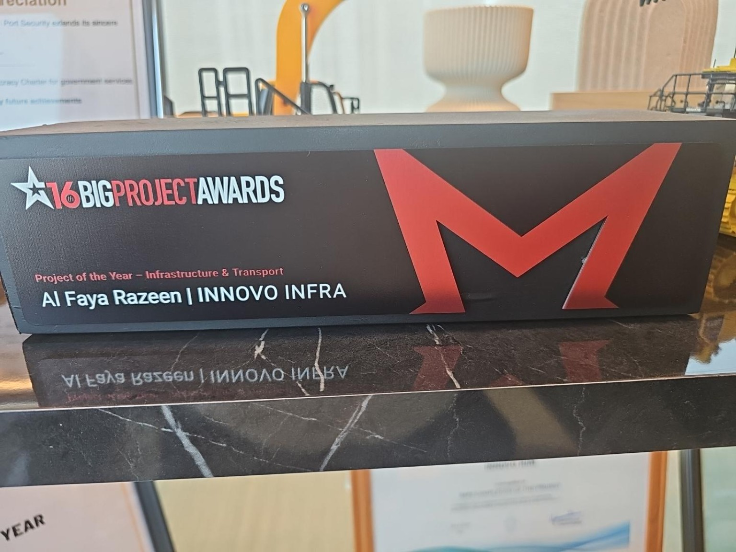
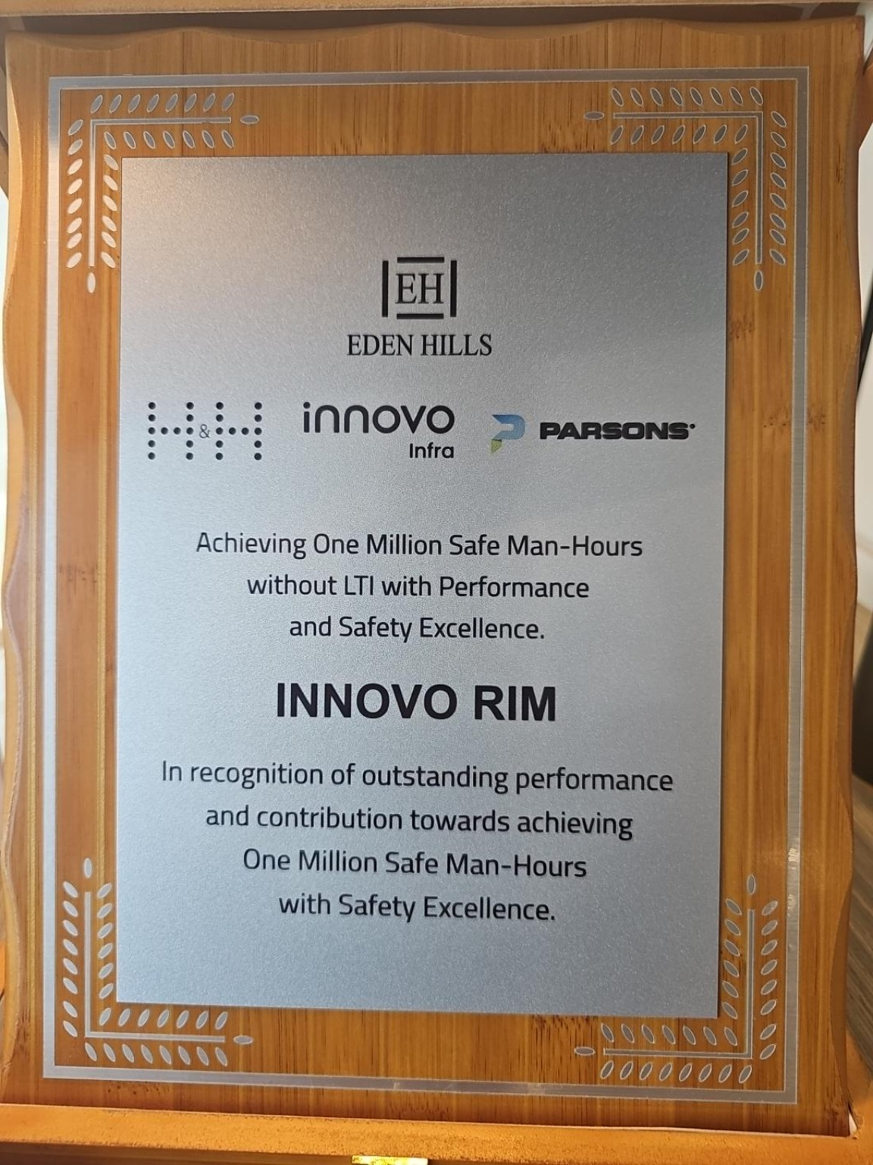
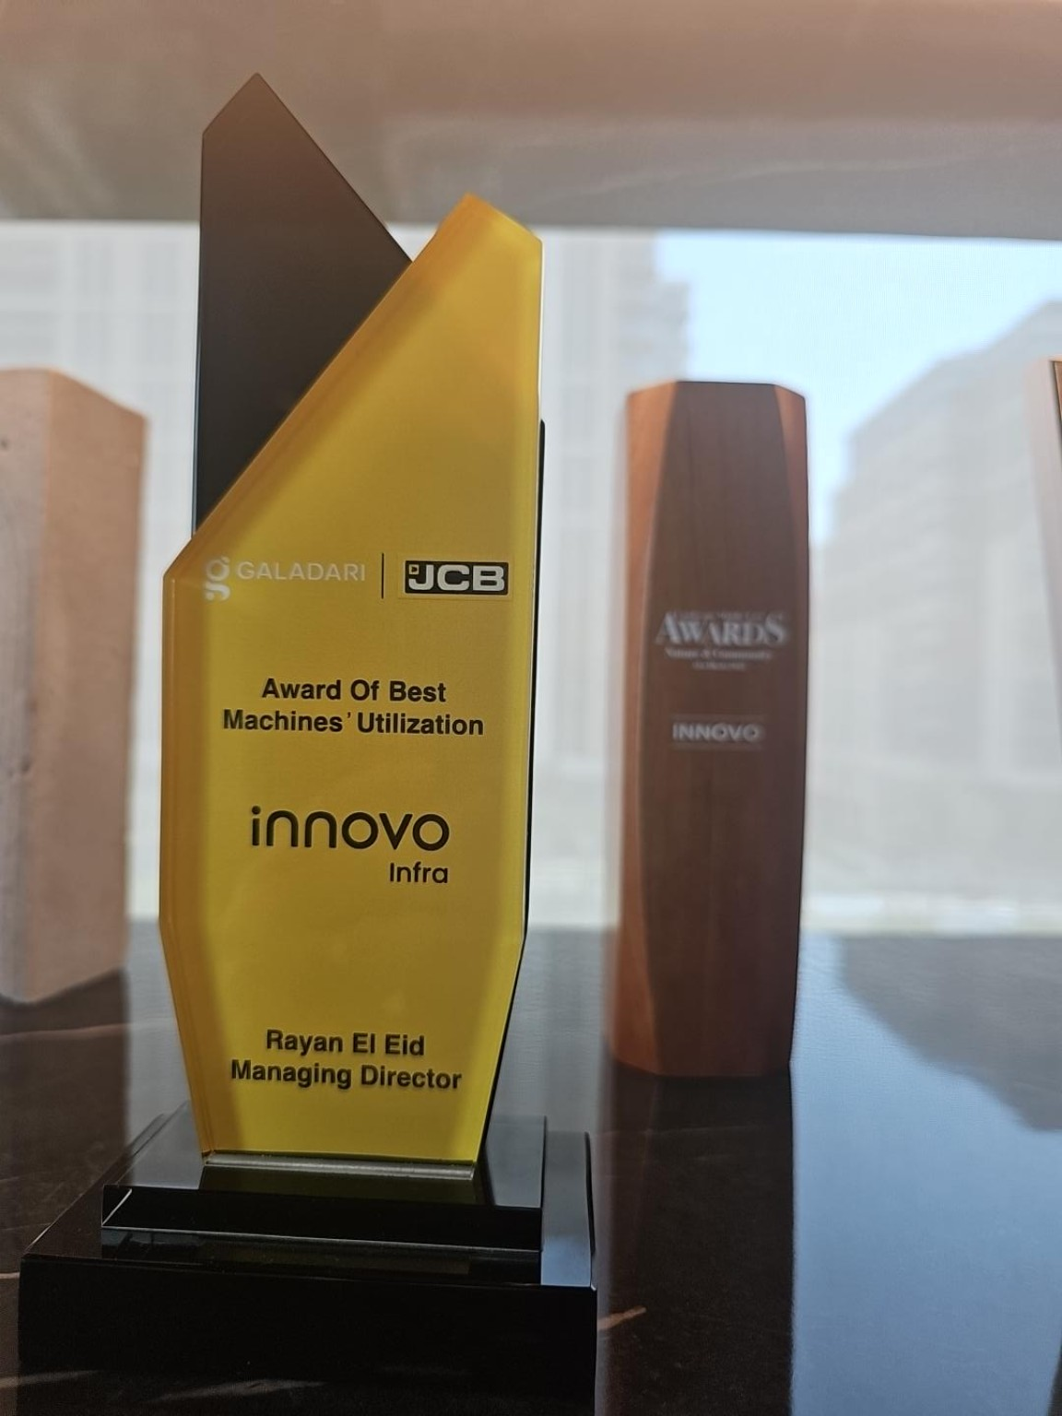
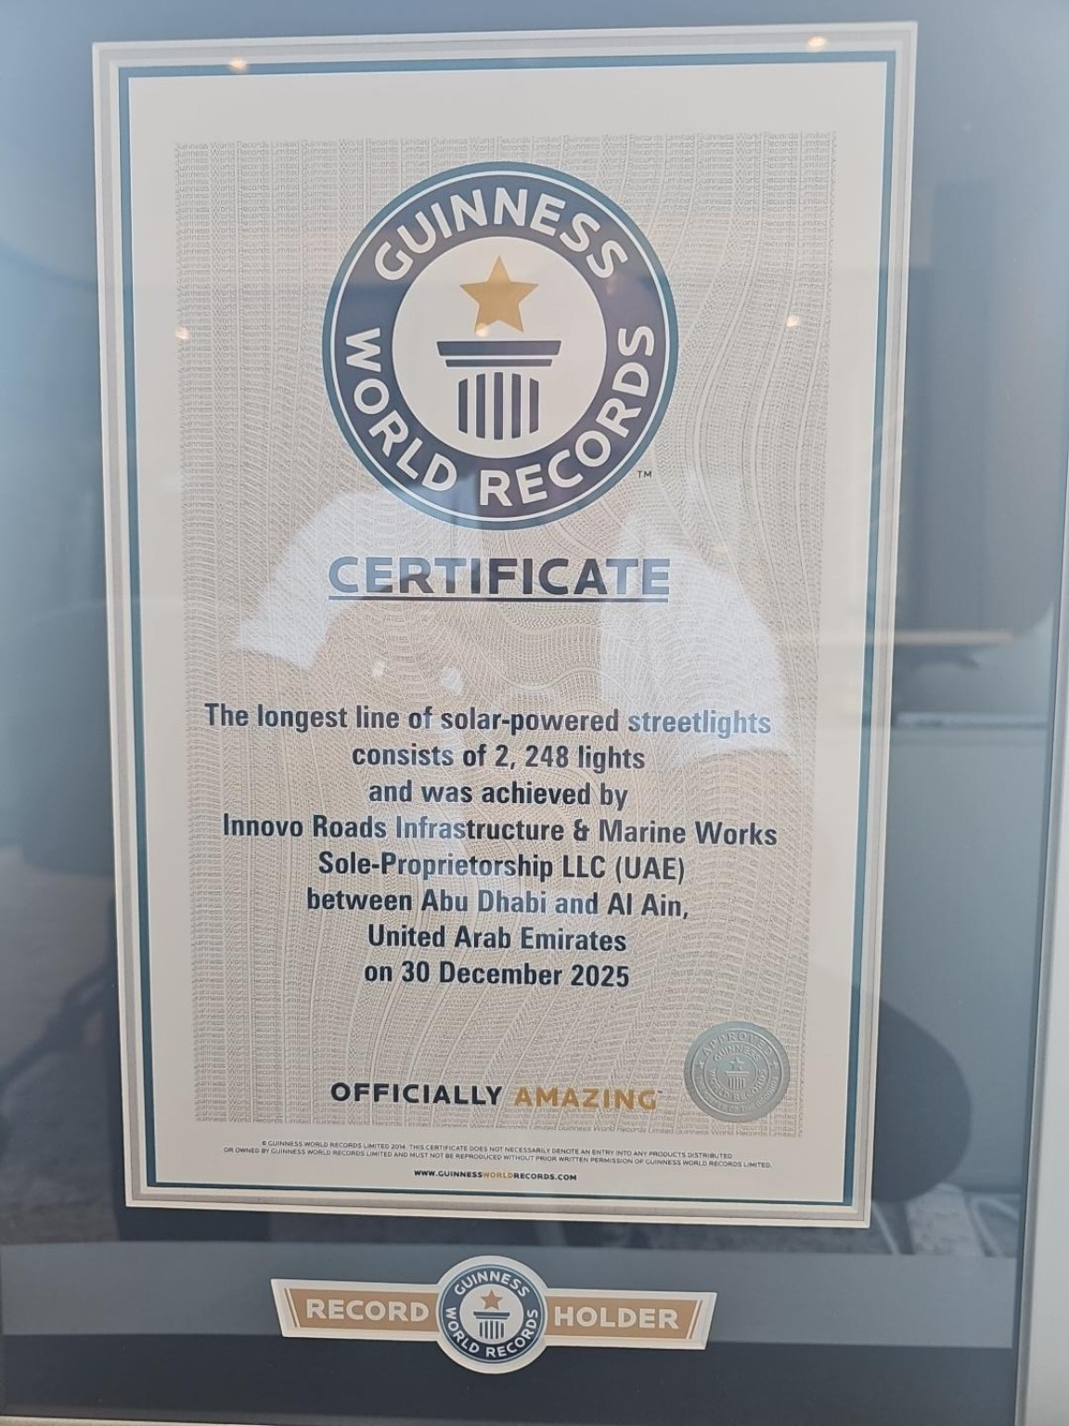
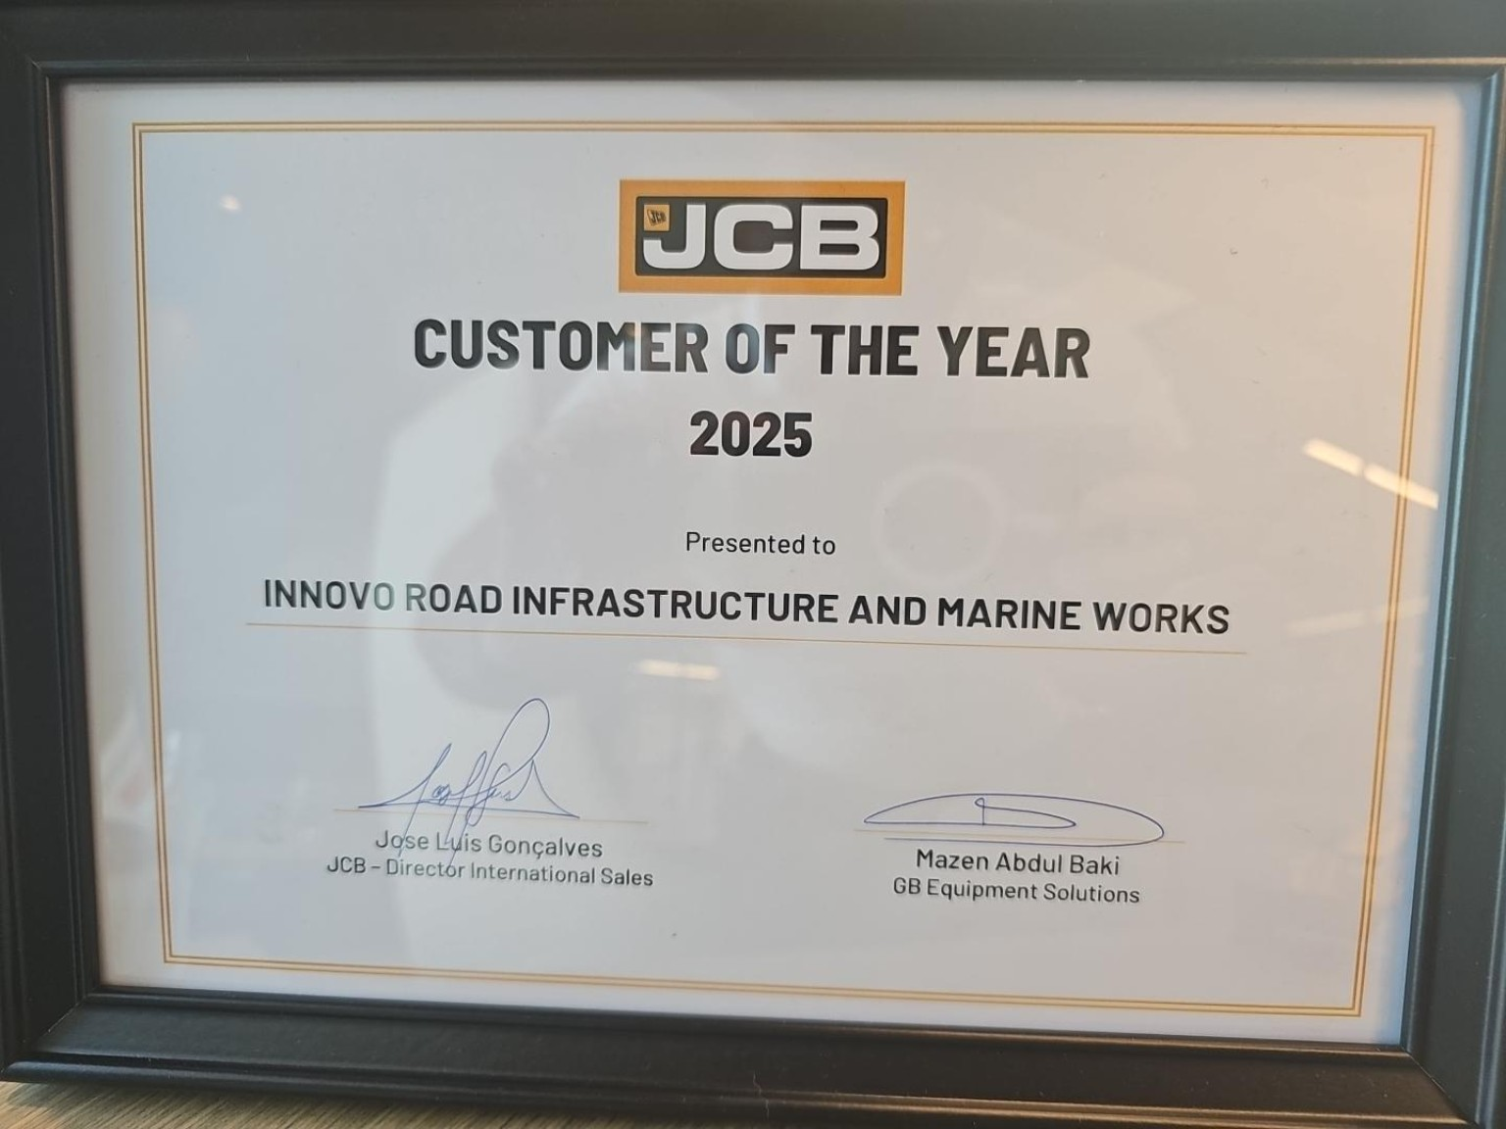
INNOVO INFRA
Our awards in pictures
Recognition since inception
Project of the Year
Safety excellence
Best machines’ utilization
Guinness World Records
JCB Customer of the Year 2025
Rayan El Eid, Managing Director • Quarterly Board Meeting 2026
07
Notes:
Original award photographs supplied by Rayan El Eid, 9 October 2026. Left to right: Eden Hills safety excellence, Galadari/JCB Best Machines’ Utilization, Guinness World Records certificate. Right top: Big Project Awards Project of the Year, Infrastructure & Transport, Al Faya Razeen. Right bottom: JCB Customer of the Year 2025. Photographs retain their original proportions.

